Slide 1

D7- UC San Diego
USA
2019 TUN Data Challenge
Presenter Name:
Cheng Gong, Jinrong Gong, Cheng Shen,
Zheng Hao Tang, Yujie Xu
October, 2019

Slide 2
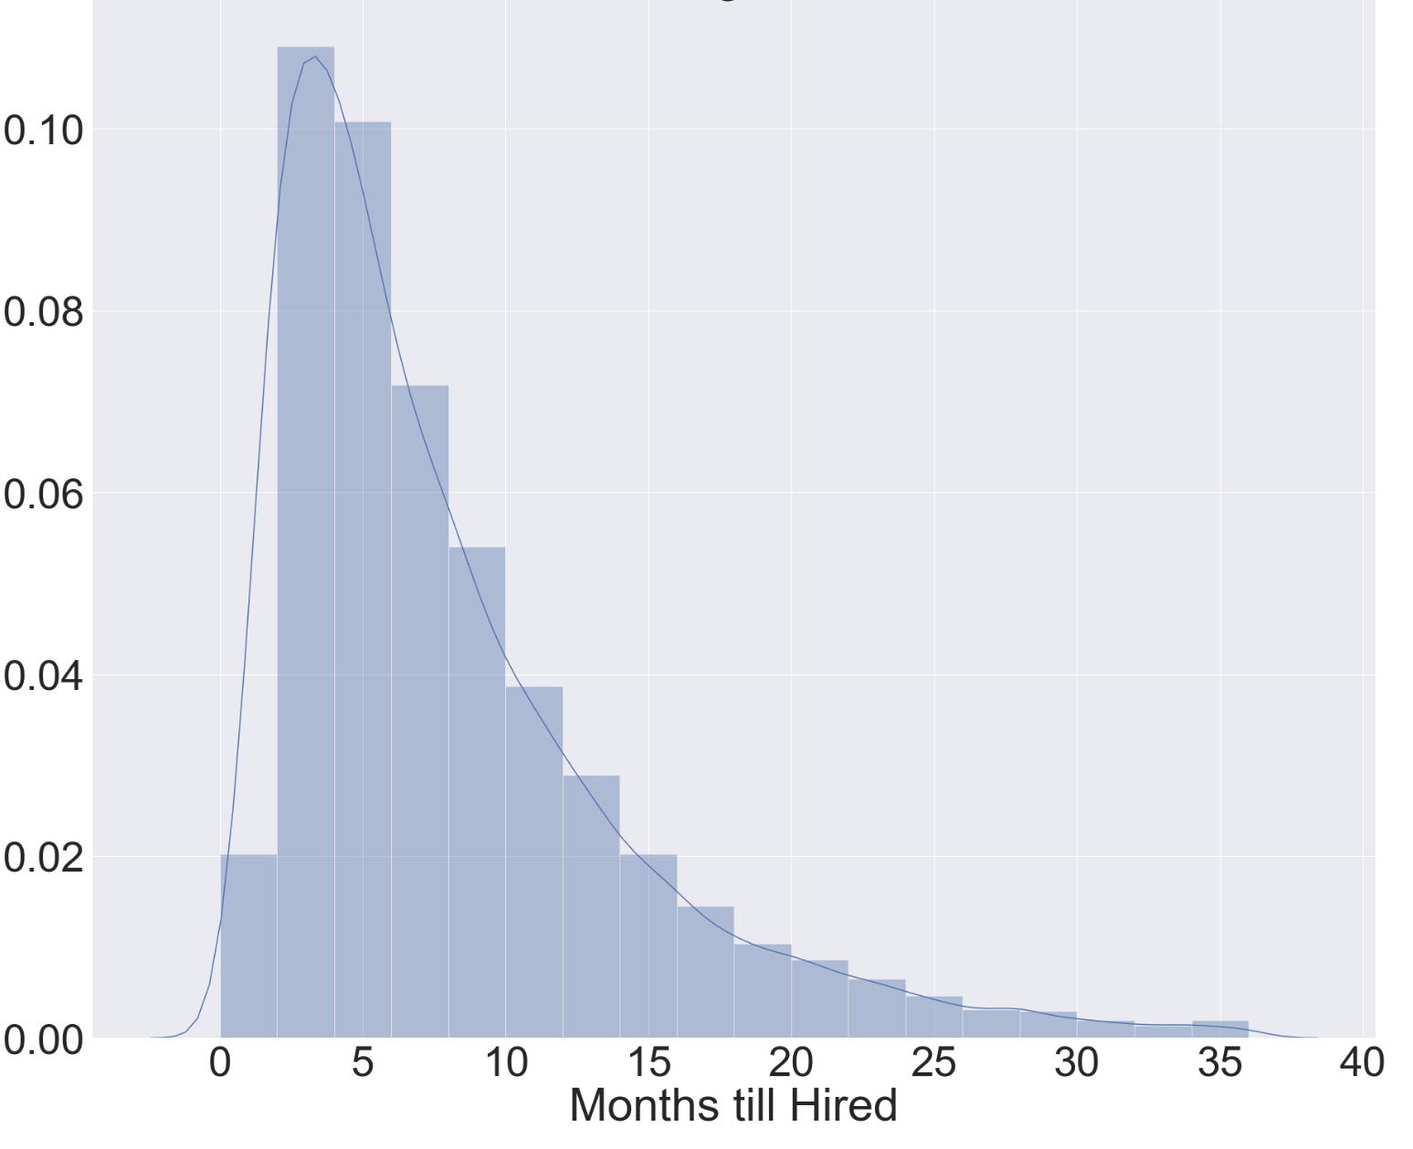
Client Services
On average, the clients will find a job in 7 months.
47.4% of clients using our Linear SVM model could find a job within 2 month from the predicted date. 75.4% within 4 months.
Model Usage:
Create a HH Account and fill in as much detail as possible. Our model handles the rest.
The most predictive features on if a candidate is hired are:
Education level (4 year college and above)
Military rank (the higher the better)
White ethnicity
Spouse is Employed
Male
Figure 1: Distribution of Hiring Time in Months
Months | Accuracy
≤ 1 | 38.186%
≤ 2 | 47.355%
≤ 3 | 63.973%
≤ 4 | 75.405%
≤ 5 | 81.625%
≤ 6 | 85.409%
21.8% spent over a year looking for jobs
Figure 2: The prediction accuracy within given months

Slide 3
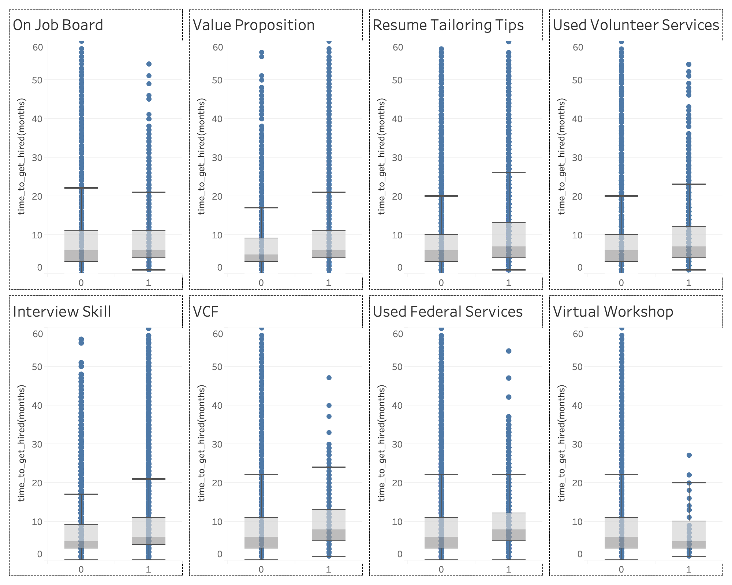
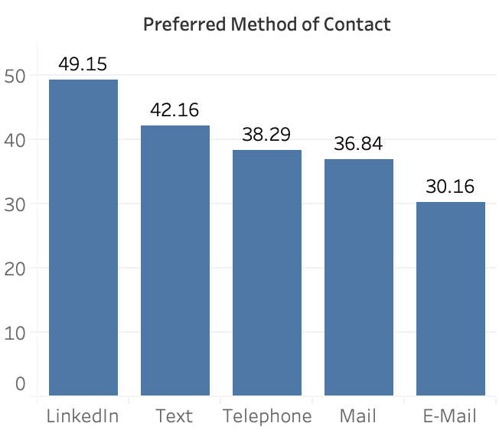
Client Services
A person is more likely to find a job if he or she uses Linkedin as preferred contact methods.
Among all the services in HH, virtual workshop is the most helpful ones
Figure 3: % hired among each Preferred Contact Method
The most popular method of contact is Telephone.
Among all LinkedIn users, 49% were hired
Need more workshops to encourage LinkedIn usage
Figure 4: The boxplots on time to get hired vs whether the client participates in a services

Slide 4
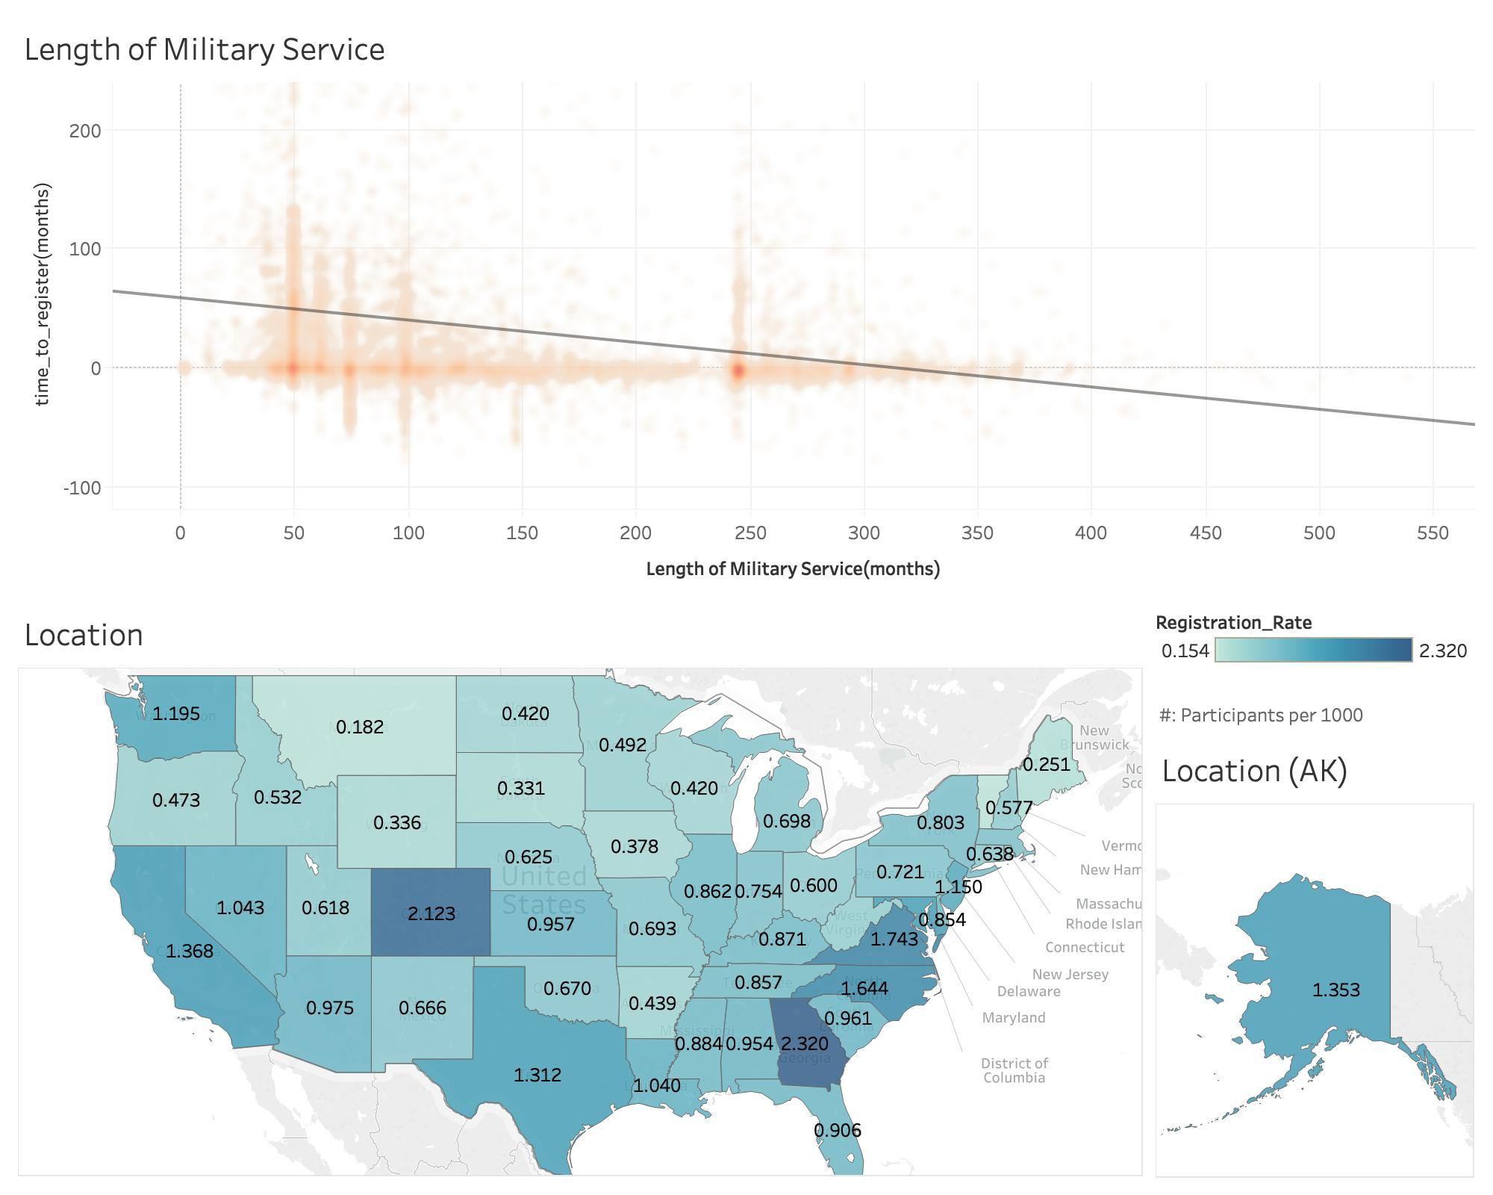
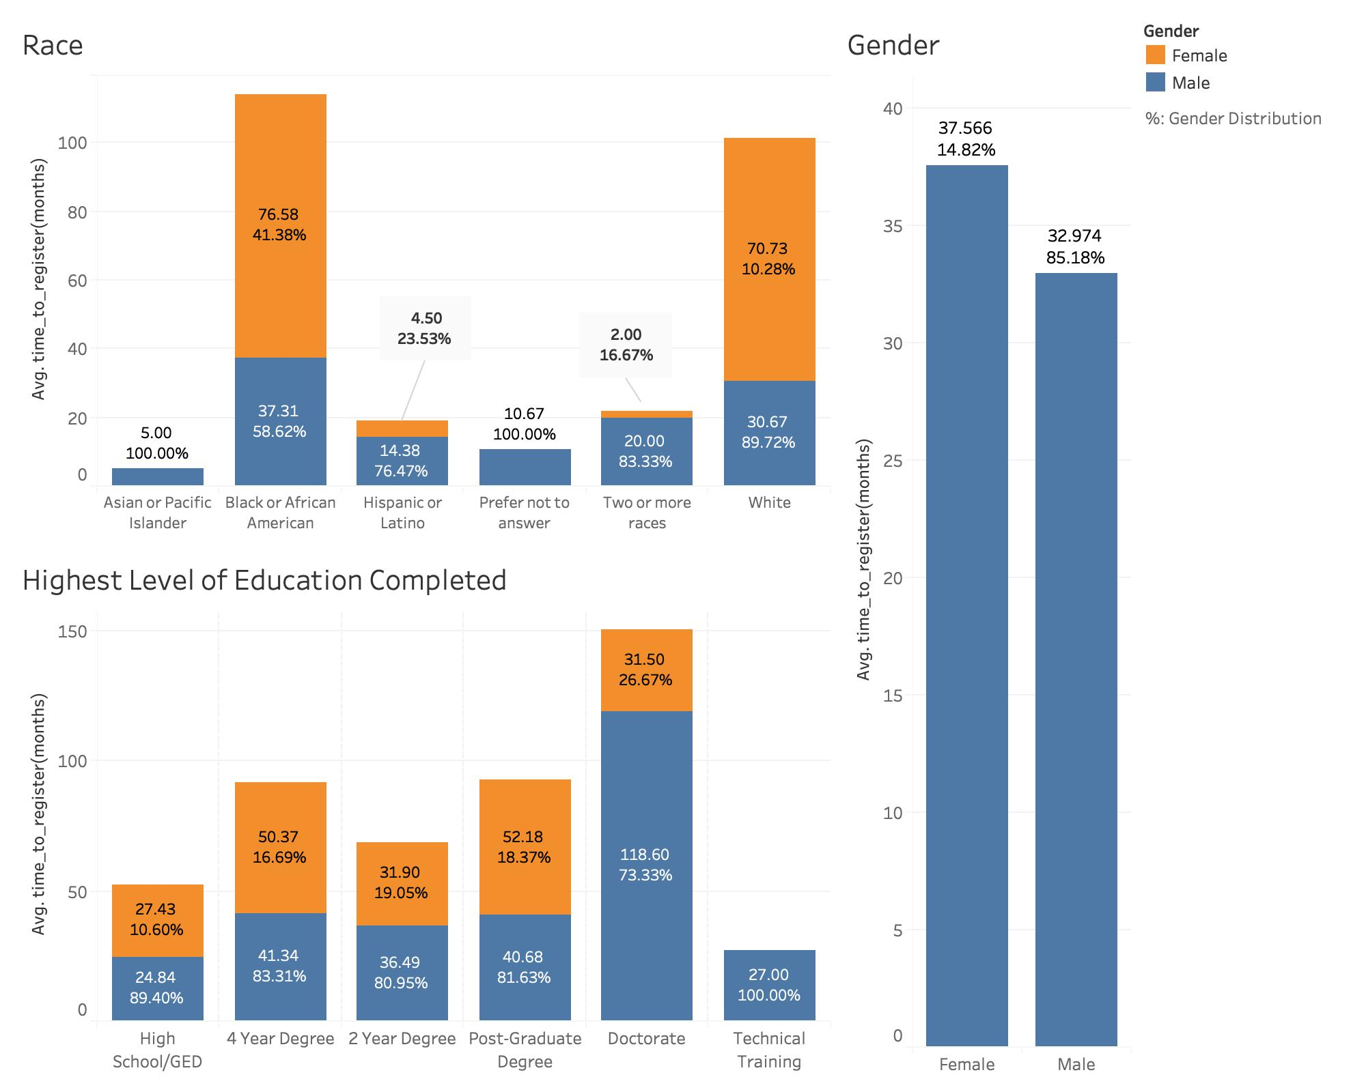
Client Services
Avg time to register: Male : Dr. Male = 1 : 3
African American and white females need the most time to register
Clients who spend longer in the military register quicker after separation
Figure 5 (top): Avg time to register vs length of military service
Figure 6 (bot): Registration rate of HH services in different states*
Figure 7: Avg time to register HH service vs demographic profiles
*https://www.va.gov/vetdata/veteran_population.asp

Slide 5
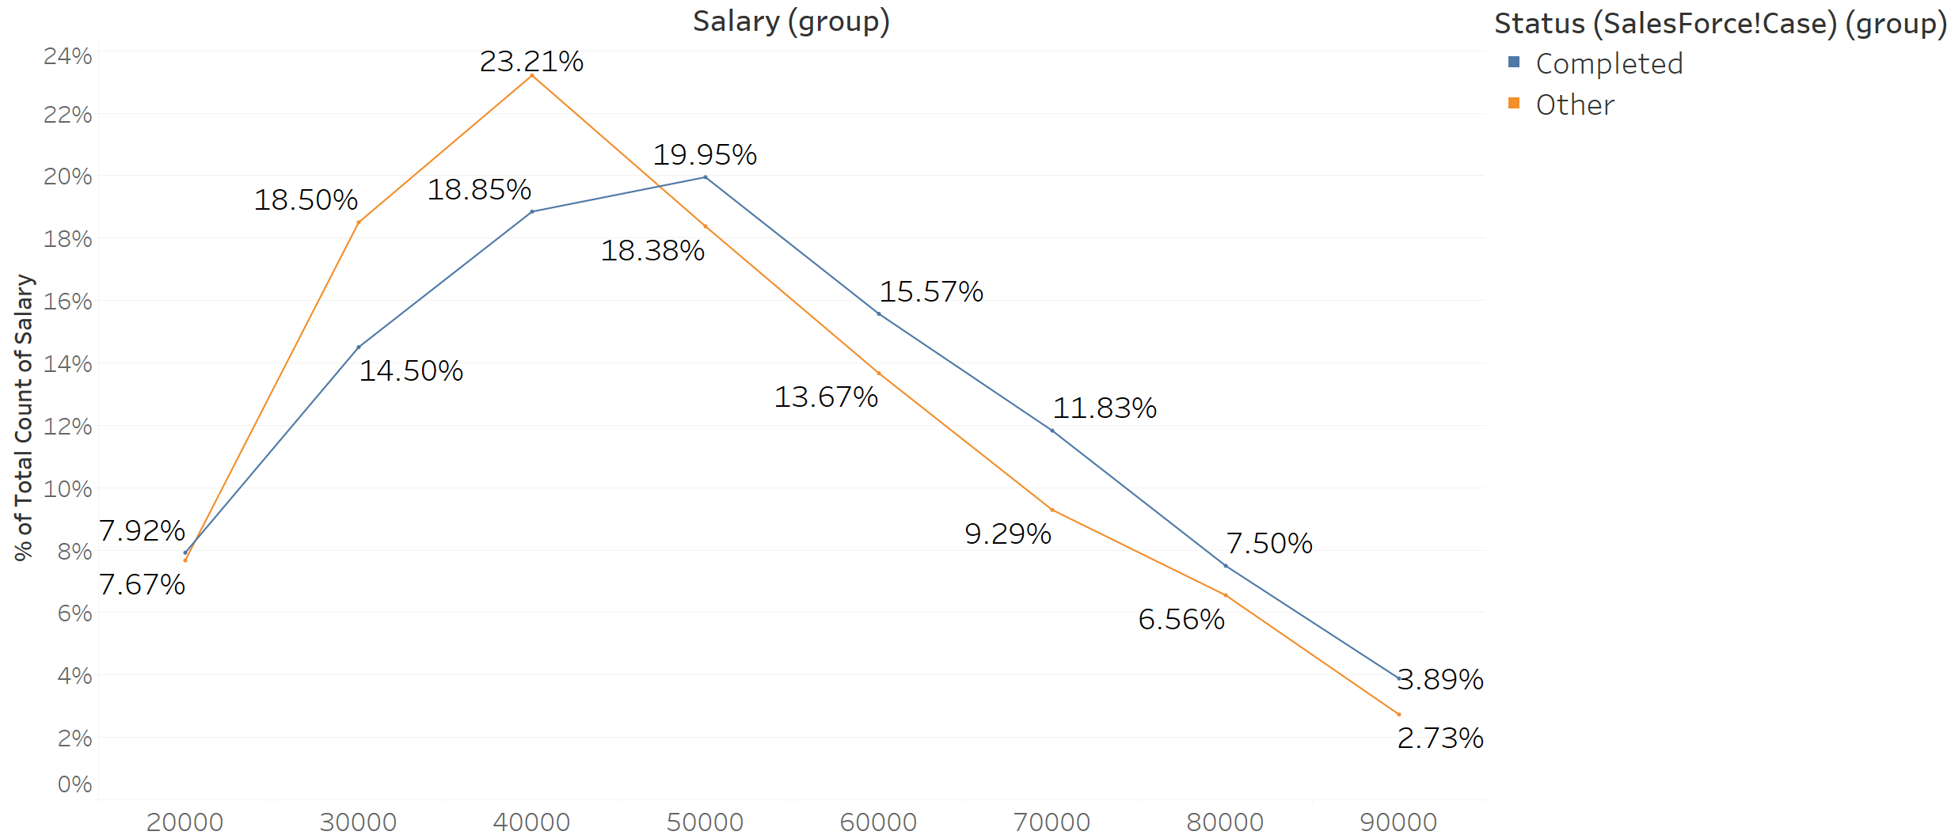
Volunteer Program (Effectiveness)
Volunteer program manages to benefit clients by improving their salary
Program users are more likely to earn high salary.
Average Salary for non-users: $40,000
Median Job Search Time: 238 days
Average Salary for service users: $48,000
Median Job Search Time: 277 days
Figure 8: Salary Distribution of Program Users

Slide 6
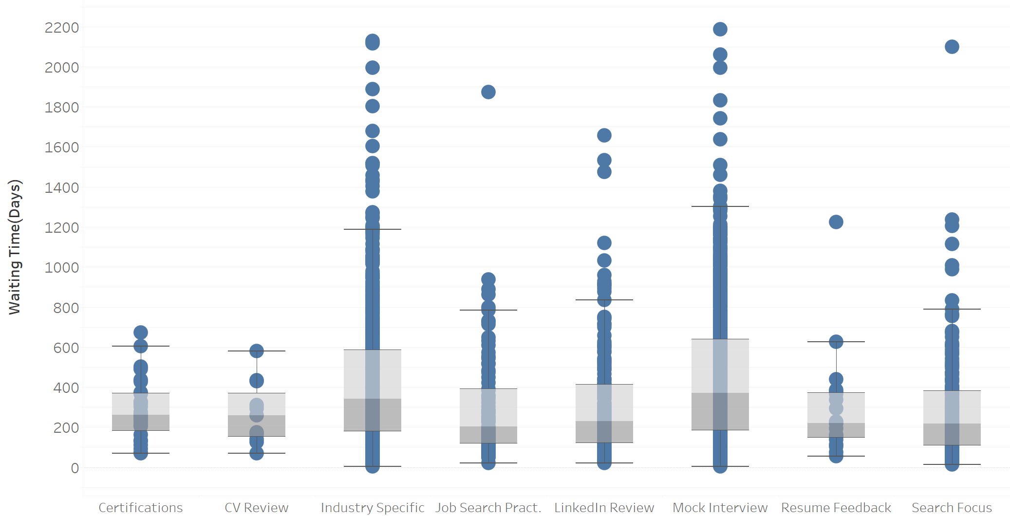
Volunteer Program (Effectiveness)
However, most effective service types are not the mostly used
Most Effective
203 Days (Job Search Practices)
221 Days (LinkedIn Review)
221 Days (Resume Feedback)
Mostly Used
38.7% (Mock Interview)
33.8% (Industry Specific)
9.3% (LinkedIn Review)
Figure 9 : Job Search Time of Different Request Types

Slide 7
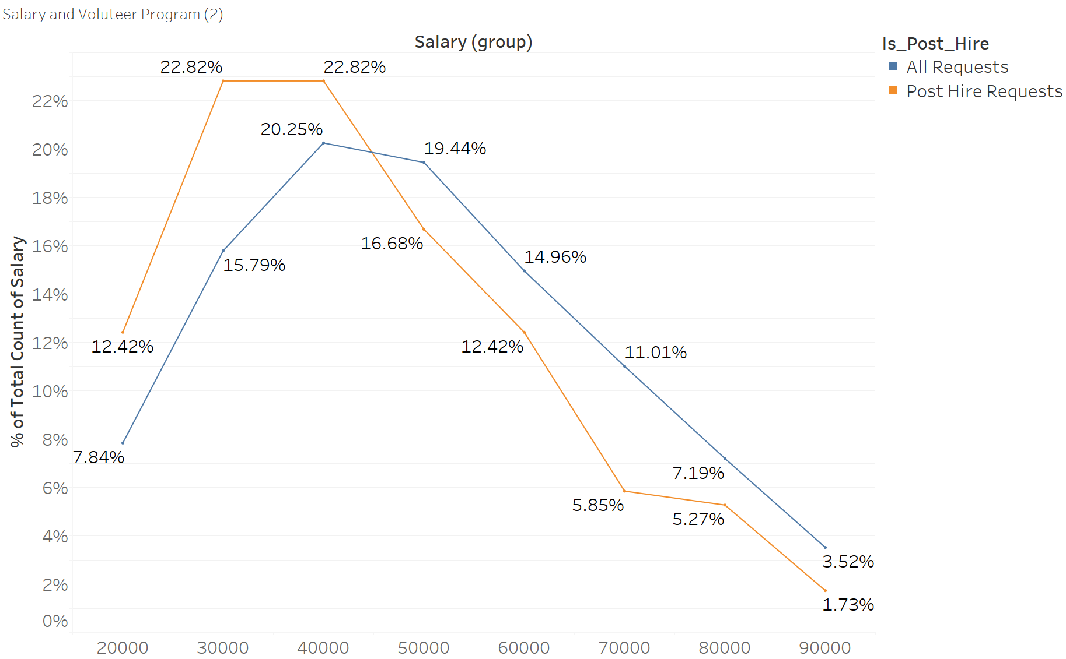
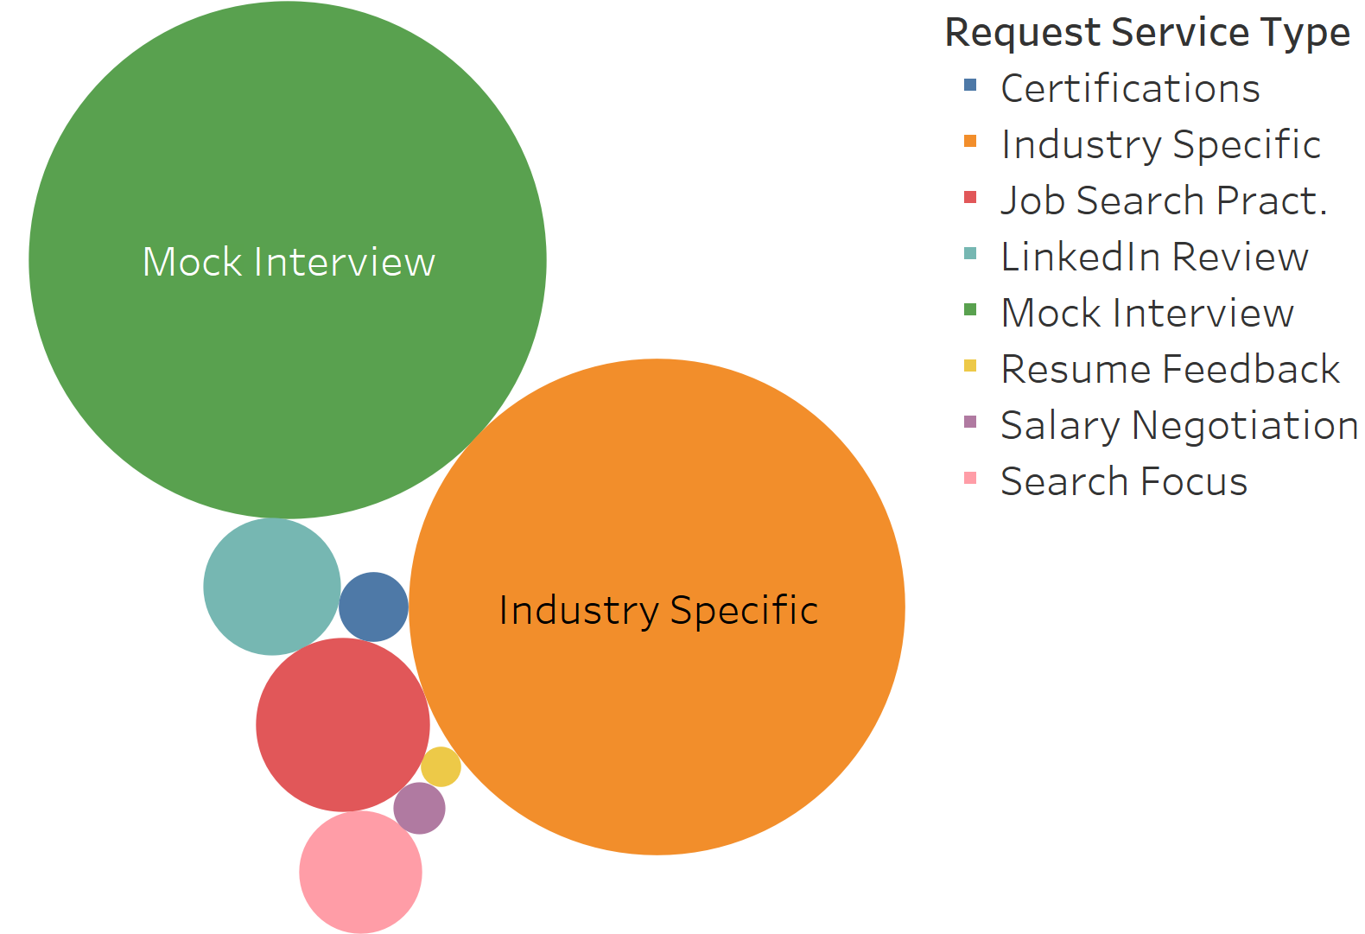
Post Hire and Multiple Offers
Relatively lower salary for post-hire request clients
Use post-hire requests to find jobs in different locations/positions.
Beneficial for obtaining multiple offers.
Salary distribution of all volunteer requests: More with Higher Salary
Clients who submit post-hire requests have relatively lower salary.
Salary distribution of post-hire requests:
More with Lower Salary
Mostly Used
 | Multiple Offer | No Multiple Offer
Volunteer User | 103 | 6726
Non Volunteer User | 107 | 23604
45.6% (Mock Interview)
41.9% (Industry Specific)
5.1% (Job Search Prac)
Figure 10 : Distribution of Post-Hire Request Types
Figure 11 (Top): Salary of Post-Hire Request Users
Figure 12 (Bottom): Chi-Square Analysis of Multiple Offer

Slide 8
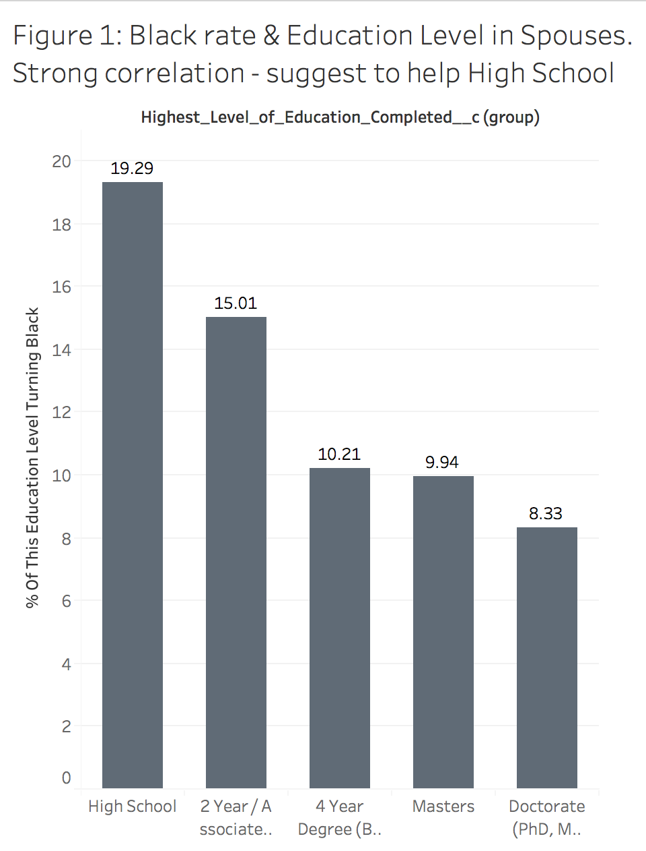
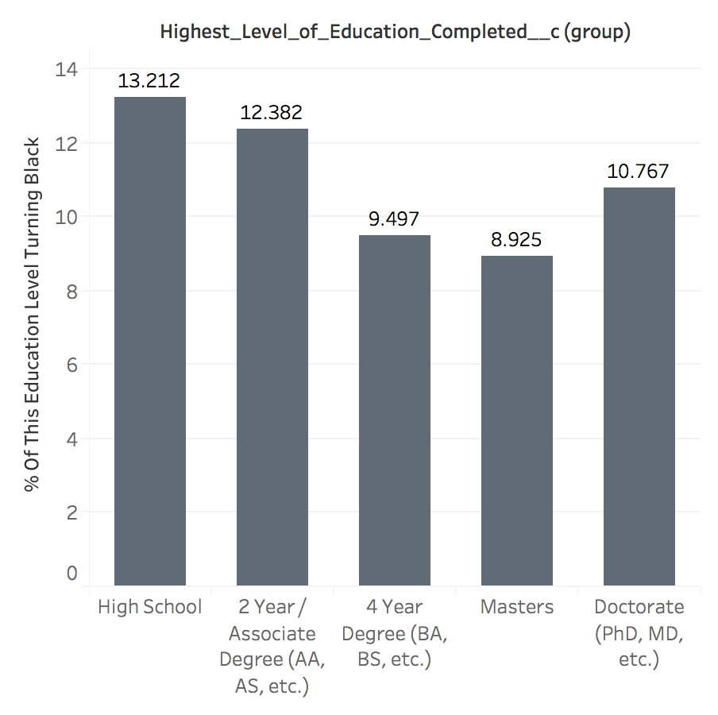
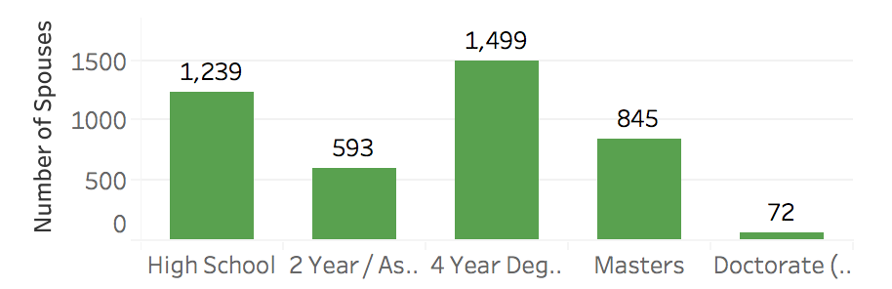
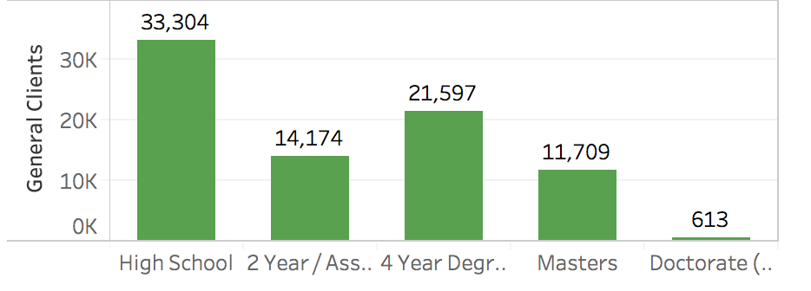
Serving Spouse Program
For spouses, a higher education level indicates strictly a lower black rate. (Veterans differ from spouses by having a high black rate for veterans with Doctorate degrees.)
We suggest focussing more on the spouses who only graduated High School to complete the assessment, instead of turning black (out before assessment).
Figure 13: (top) Turning-Black Rate across Education Levels
Spouses
Veterans
Figure 14: (bottom) Population in each Education Level

Slide 9
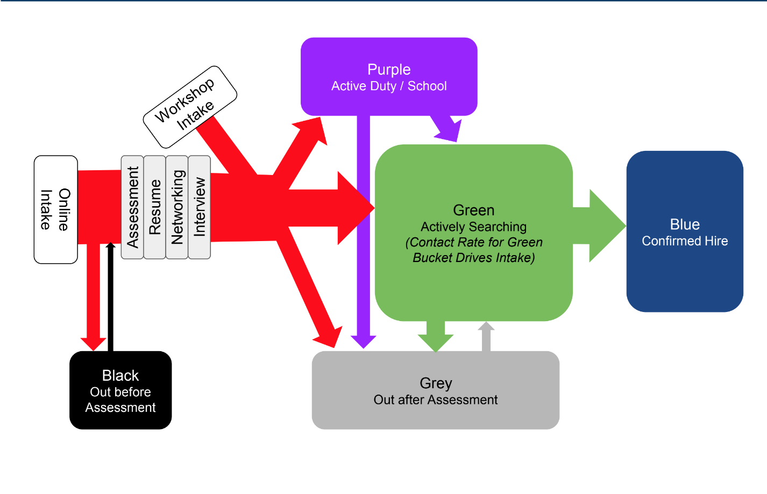
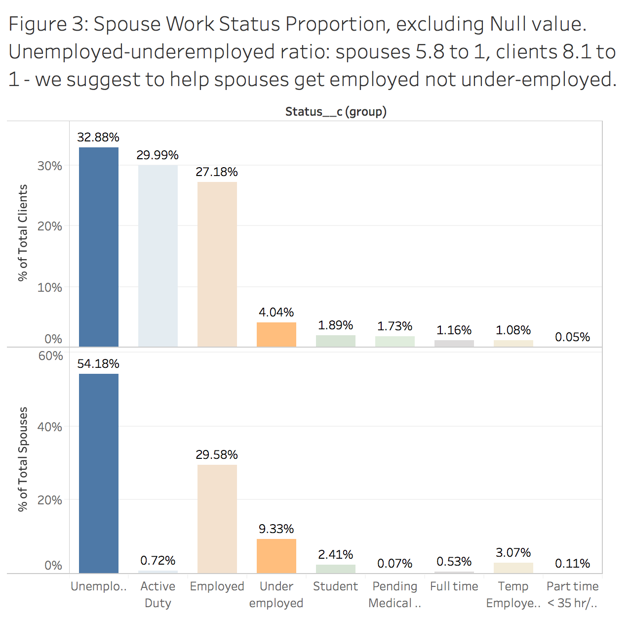
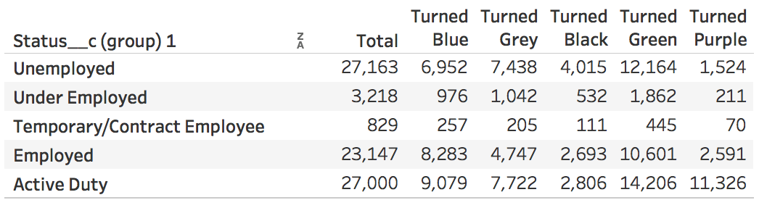
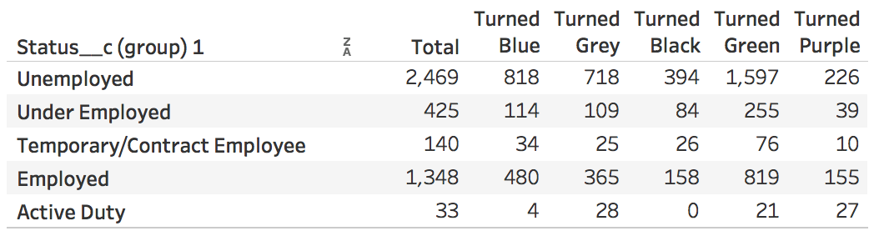
Serving Spouse Program
Comparing to veterans, spouses are more under-employed; employment is even fewer.
However, spouses do better after being in the program.
Figure 15: Population across employment status
Figure 16: employment status turning into color...
General Clients (Veterans)
<
<
Spouses
>
>
Notes:
Comparing to veterans, spouses do tend to stay under-employed than unemployed, while employment is even fewer, confirming the suspicion.

Slide 10
Conclusion
Client service
Linkedin profiles, 4-year degree or above, high ranks in the military,
white ethnicity, and male gender help find job placement
The most helpful HH service is virtual workshop
Registration time is inversely correlated with length of military services
The south-eastern regions have a higher registration rate than the west
Volunteer service
Volunteer Services help clients get higher salary and multiple offers
Better management needed to help users find suitable services and get hired faster
Spouse services
Spouses tend to be more underemployed and unemployed.
The lower the education, the lower the motivation to finish assessment.
Our service provides a greater value to spouses.

